Slide 1
DBMS
Data Models

Slide 2
Data Models
Data Model can be defined as an integrated collection of concepts for describing and manipulating data, relationships between data, and constraints on the data in an organization.

Slide 3
A Data model is a representation of reality, ‘real world’ objects and events, associations. It is an abstraction that concentrates on the essential, inherent aspects an organization and ignores the accidental properties. A data model represents the organization itself. It should provide the basic concepts and notations that will allow database designers and end users unambiguously and accurately to communicate their understanding of the organizational data.

Slide 4
A data model comprises of three components:
• A structural part, consisting of a set of rules according to which databases can be constructed.
• A manipulative part, defining the types of operation that are allowed on the data (this includes the operations that are used for updating or retrieving data from the database and for changing the structure of the database).
• Possibly a set of integrity rules, which ensures that the data is accurate.
The purpose of a data model is to represent data and to make the data understandable. There have been many data models proposed in the literature.

Slide 5
They fall into three broad categories:
Object Based Data Models
Record based Data Models
Physical Data Models
The object based and record based data models are used to describe data at the conceptual and external levels, the physical data model is used to· describe data at the internal level.

Slide 6
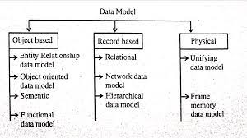

Slide 7
Object based Data Models
Object based data models use concepts such as entities, attributes, and relationships. An entity is a distinct object (a person, place, concept, and event) in the organization that is to be represented in the database. An attribute is a property that describes some aspect of the object that we wish to record, and a relationship is an association between entities.
Some of the more common types of object based data model are:
• Entity-Relationship
• Object Oriented
• Semantic
• Functional

Slide 8
E R Model
Entity-Relationship Model or simply ER Model is a high-level data model diagram. In this model, we represent the real-world problem in the pictorial form to make it easy for the stakeholders to understand. It is also very easy for the developers to understand the system by just looking at the ER diagram. We use the ER diagram as a visual tool to represent an ER Model.
.

Slide 9
ER diagram has the following three components:
Entities: Entity is a real-world thing. It can be a person, place, or even a concept.
Example: Teachers, Students, Course, Building, Department, etc are some of the entities of a School Management System.
Attributes: An entity contains a real-world property called attribute. This is the characteristics of that attribute.
Example: The entity teacher has the property like teacher id, salary, age, etc.

Slide 10
Relationship: Relationship tells how two attributes are related.
Example: Teacher works for a department.
Mapping cardinalities −
one to one
one to many
many to one
many to many

Slide 11
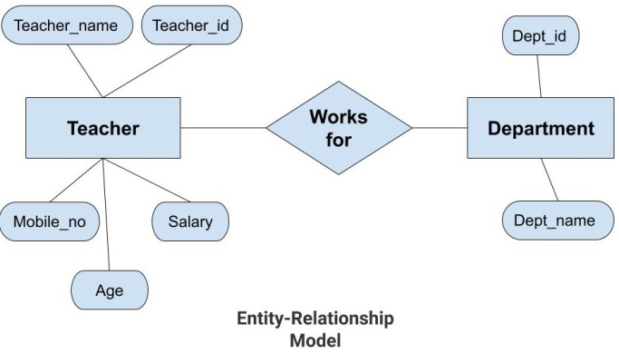

Slide 12
In the above diagram, the entities are Teacher and Department. The attributes of Teacher entity are Teacher_Name, Teacher_id, Age, Salary, Mobile_Number.
The attributes of entity Department entity are Dept_id, Dept_name. The two entities are connected using the relationship. Here, each teacher works for a department.

Slide 13
Features of ER Model
Graphical Representation for Better Understanding: It is very easy and simple to understand so it can be used by the developers to communicate with the stakeholders.
ER Diagram: ER diagram is used as a visual tool for representing the model.
Database Design: This model helps the database designers to build the database and is widely used in database design.

Slide 14
Advantages of ER Model
Simple: Conceptually ER Model is very easy to build. If we know the relationship between the attributes and the entities we can easily build the ER Diagram for the model.
Effective Communication Tool: This model is used widely by the database designers for communicating their ideas.
Easy Conversion to any Model: This model maps well to the relational model and can be easily converted relational model by converting the ER model to the table. This model can also be converted to any other model like network model, hierarchical model etc.

Slide 15
Disadvantages of ER Model
No industry standard for notation: There is no industry standard for developing an ER model. So one developer might use notations which are not understood by other developers.
Hidden information: Some information might be lost or hidden in the ER model. As it is a high-level view so there are chances that some details of information might be hidden.

Slide 16
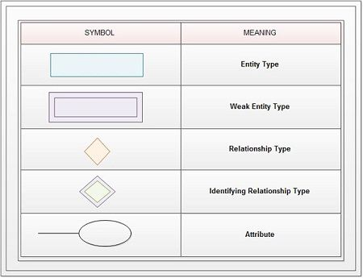

Slide 17
Object Oriented Data Model
The real-world problems are more closely represented through the object-oriented data model. In this model, both the data and relationship are present in a single structure known as an object. We can store audio, video, images, etc in the database which was not possible in the relational model(although you can store audio and video in relational database, but it is advised not to store in the relational database). In this model, two are more objects are connected through links. We use this link to relate one object to other objects. This can be understood by the example given below.

Slide 18
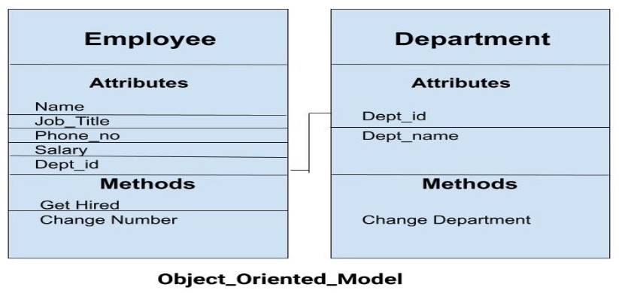

Slide 19
In the example, we have two objects Employee and Department. All the data and relationships of each object are contained as a single unit. The attributes like Name, Job_title of the employee and the methods which will be performed by that object are stored as a single object. The two objects are connected through a common attribute i.e. the Department_id and the communication between these two will be done with the help of this common id.

Slide 20
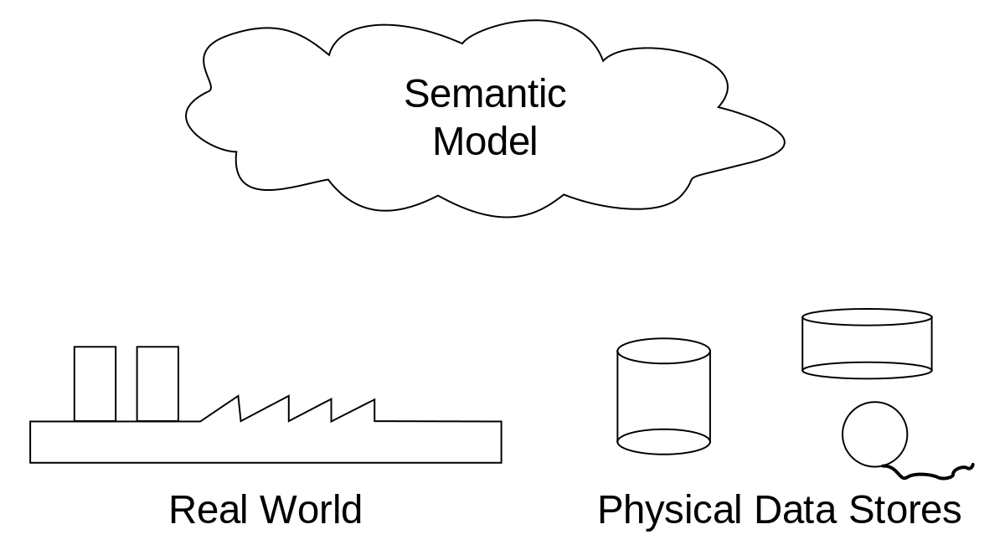
Semantic Data Model
Entities in Semantic systems represent the equivalent of a record in a relational system or an object in an OO system but they do not include behaviour (methods). They are abstractions ‘used to represent real world (e.g. customer) or conceptual (e.g. bank account) objects.

Slide 21
The semantic data model is a method of structuring data in order to represent it in a specific logical way. It is a conceptual data model that includes semantic information that adds a basic meaning to the data and the relationships that lie between them. This approach to data modeling and data organization allows for the easy development of application programs and also for the easy maintenance of data consistency when data is updated.
Abstractions used in a semantic data model:
Classification - "instance_of" relations
Aggregation - "has_a" relations
Generalization - "is_a" relations

Slide 22
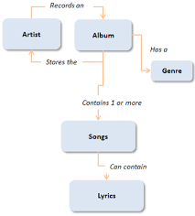

Slide 23
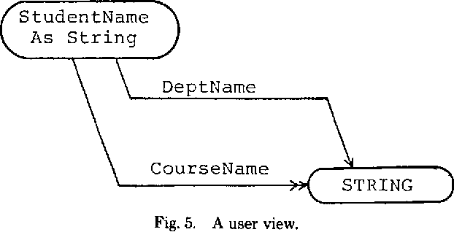
Functional Data Model
The Functional data model is now almost twenty years old. The original idea was to’ view the database as a collection of extensionally defined functions and to use a functional language for querying the database.

Slide 24
Record based Data Models
Record based logical models are used in describing data at the logical and view levels. In contrast to object based data models, they are used to specify the overall logical structure of the database and to provide a higher-level description of the implementation.
Record based models are so named because the database is structured in fixed format records of several types. Each record type defines a fixed number of fields, or attributes, and each field is usually of a fixed length.

Slide 25
The three most widely accepted record based data models are:
• Hierarchical Model
• Network Model
• Relational Model
The relational model has gained favor over the other two in recent years. The network and hierarchical models are still used in a large number of older databases.

Slide 26
Hierarchical Model
Hierarchical Model was the first DBMS model. This model organizes the data in the hierarchical tree structure. The hierarchy starts from the root which has root data and then it expands in the form of a tree adding child node to the parent node. This model easily represents some of the real-world relationships like food recipes, sitemap of a website etc. Example: We can represent the relationship between the shoes present on a shopping website in the following way:

Slide 27
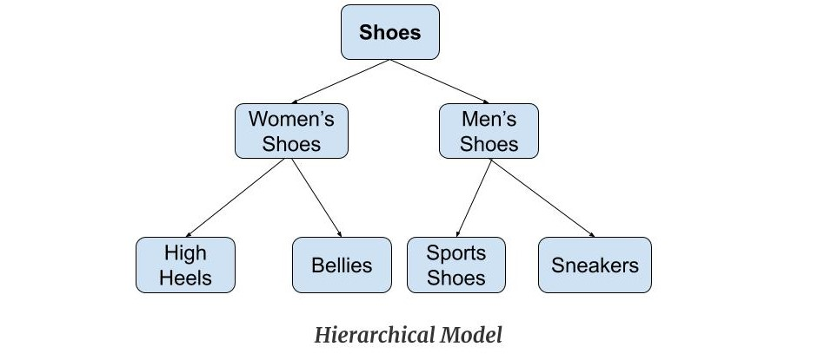

Slide 28
Network Model
This model is an extension of the hierarchical model. It was the most popular model before the relational model. This model is the same as the hierarchical model, the only difference is that a record can have more than one parent. It replaces the hierarchical tree with a graph. Example: In the example below we can see that node student has two parents i.e. CSE Department and Library. This was earlier not possible in the hierarchical model.

Slide 29
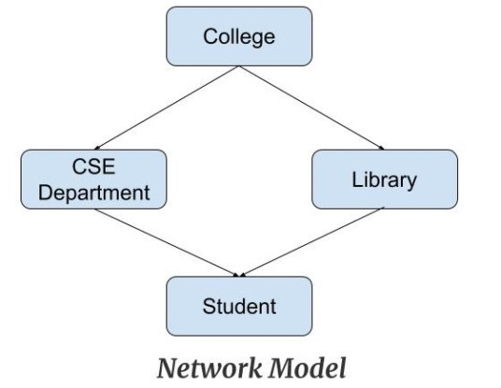

Slide 30
Relational Model
Relational Model is the most widely used model. In this model, the data is maintained in the form of a two-dimensional table. All the information is stored in the form of row and columns. The basic structure of a relational model is tables. So, the tables are also called relations in the relational model. Example: In this example, we have an Employee table.

Slide 31
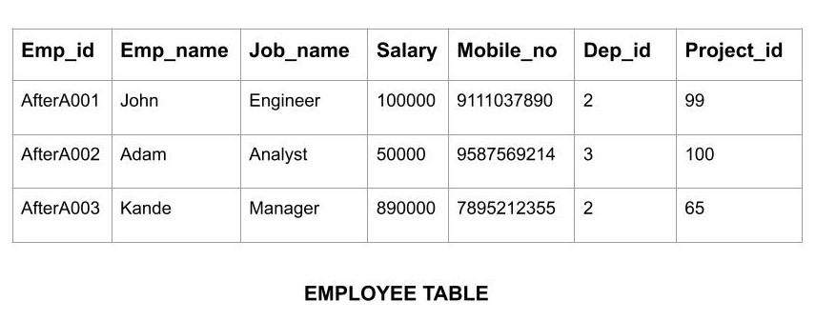

Slide 32
Physical Data Models
Physical data models describe how data is stored in the computer, representing information such as record structures, record ordering, and access paths. There are not as many physical data models as logical data models.
There are two types of Physical data models are used:
Unifying Data Model
Frame Memory Data Model

Slide 33
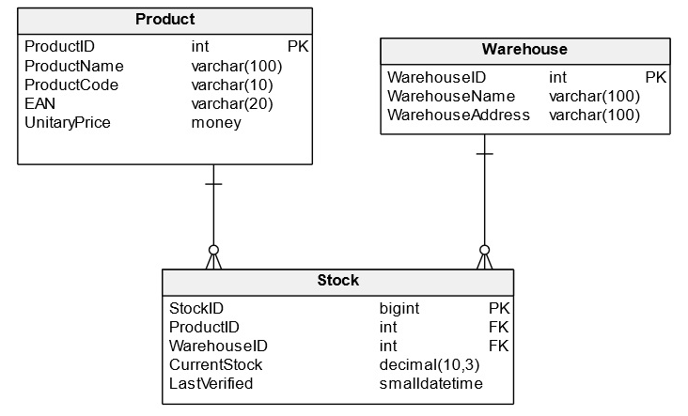

Slide 34
Thank YOU

